Slide 1

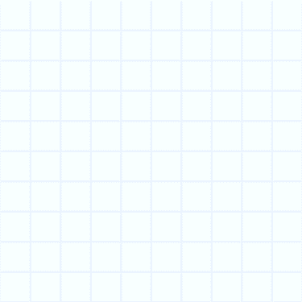

Use Venn diagrams to sort.
We’re going to use these two hoops to sort capital letters into two sets.
A
1 or more
Curved Lines
1 or more
Straight Lines
B
C
Which set do you think will have the most letters?
B has straight and curved lines, so it goes in the intersection.
All its lines are straight.
C is a
curved line!
Where should the letter A go?
Where should the letter B go?
Where should the letter C go?

Slide 2
Use Venn diagrams to sort.
Let’s check if we agree where to place the other letters...
1 or more
Straight Lines
1 or more
Curved Lines
X
Y
T
W
C
A
M
K
B
G
S
Z
O
E
D
V
I
R
U
Which set has most letters? How does this compare with what we thought?
F
Q
L
N
J
H
P

