Slide 1

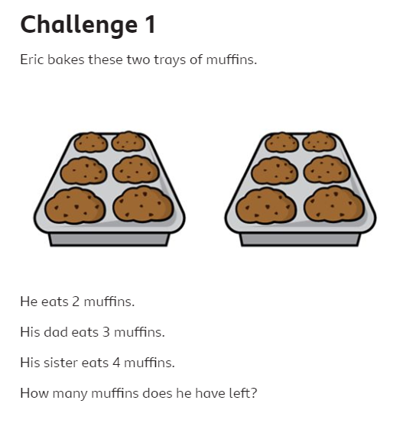

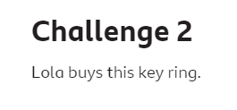
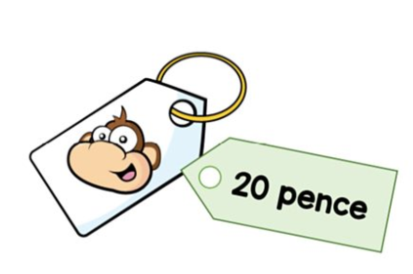
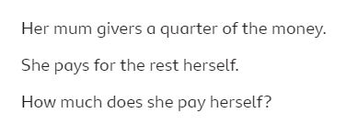
Maths Challenge

Slide 2
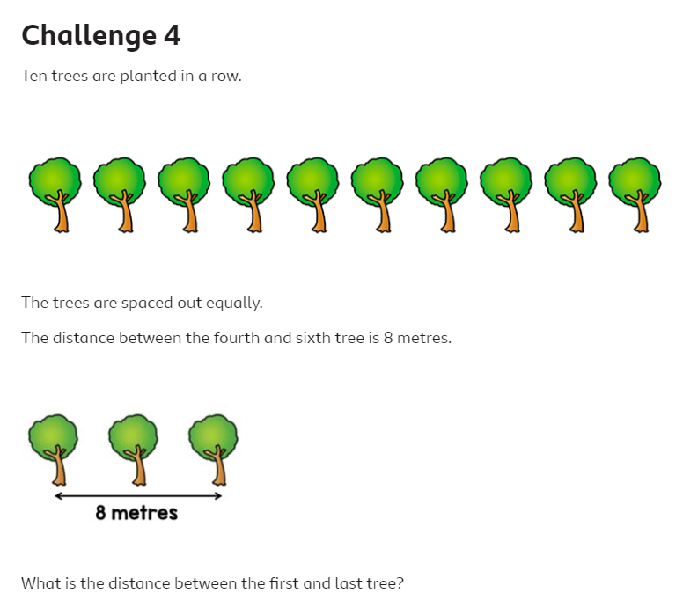
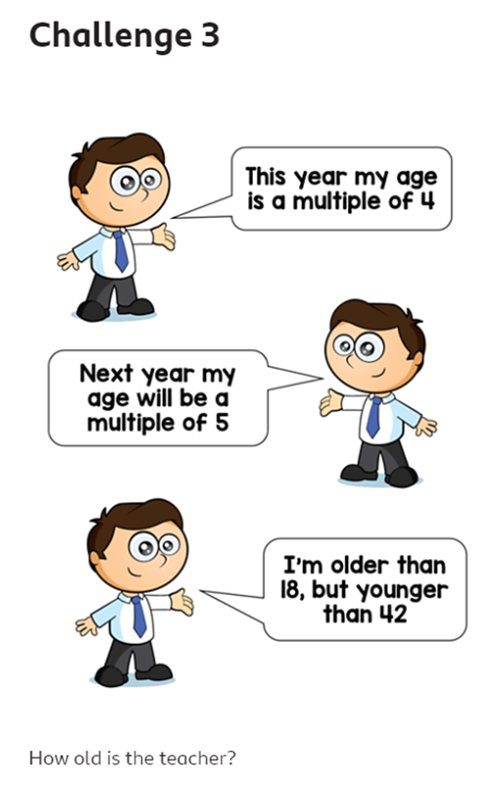
The trees are spaced out equally.
The distance between them the 4th and 6th tree is:
What is the distance between the first and last tree?
Top tip: write out the numbers 1-42 and, using each clue, cross out the ones it can’t be.

