Slide 1
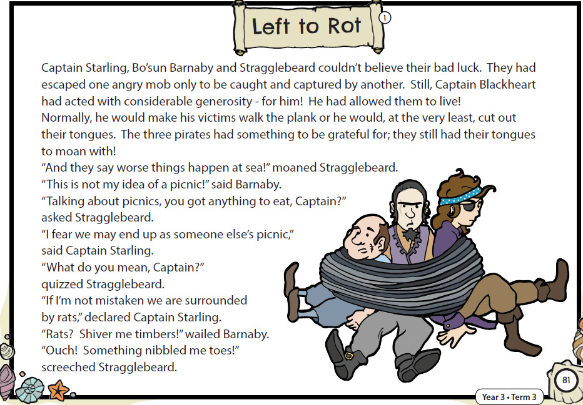
Lesson One – Read the text

Slide 2
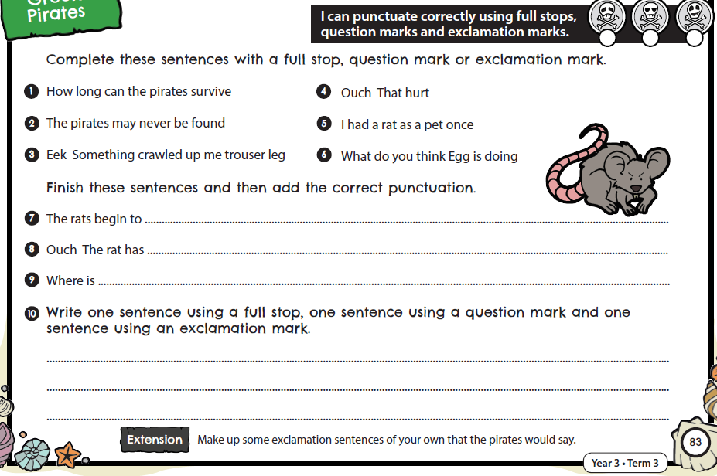
Lesson One: Activity

Slide 3
Lesson One: Answers
?
!
.
.
.
!
.
?
nibble their toes.
!
bitten me.
These are just suggested answers.
the rat catcher ?
Many different ideas are acceptable here.

Slide 4
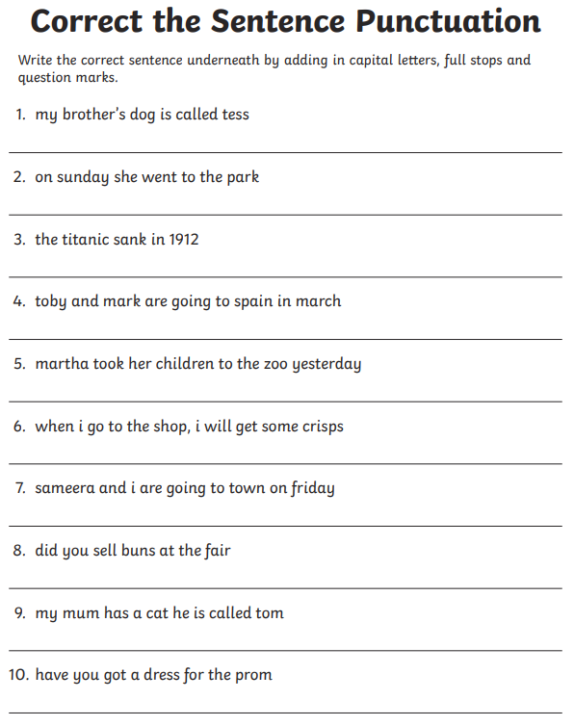
Lesson Two: Activity

Slide 5
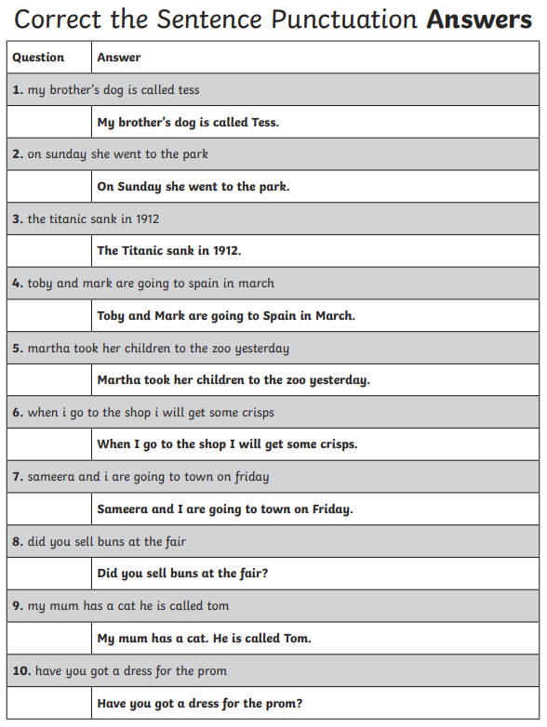
Lesson Two: Answers

