Slide 1
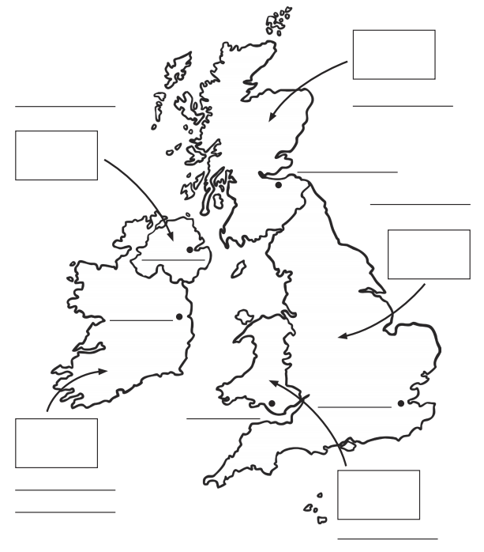
The United Kingdom
Lesson One
Label the four countries: England, Wales, Scotland, Northern Ireland
Label the Republic of Ireland and its capital city (not part of the UK)
Label the capital city of each country
Mark these places with a dot and write their name beside the dot: Southampton, Portsmouth, Isle of Wight

Slide 2
Lesson Two
Draw the flag for each country.
Find out which flower represents each country and draw it.
Find out which animal represents each country and draw it.

