Slide 1
Welcome
Please collect your information leaflet from the table.
                Thank you!

Slide 2
Why do we do the tests?
The tests are a compulsory part of the National Curriculum for all children in state schools in England in Year 6.
They are designed to test the children’s knowledge of the Key Stage 2 Curriculum in Reading, Spelling Punctuation, Grammar and Maths, including basic arithmetic.
They provide a “snapshot” of a child’s attainment on one day at the end of the Key Stage.

Slide 3
Why do we do the tests?
Your child will also be awarded a teacher assessment which will tell you whether the teacher thinks they have met the required standard taking into account all aspects of that subject.
The assessments made through the national tests do not cover all the aspects of each subject.

Slide 4
Why do we do the tests?
As part of the government’s review of assessment at Key Stage 2, writing will be assessed solely through teacher assessment
To make sure these assessments are accurate and robust, they are moderated in school, across local schools and possibly by the Local Authority.
We expect to be moderated by the Local Authority this year.

Slide 5
Levels have gone!
The expected scaled score on the test is 100.
A score of 100 or above means that your child has met the required standard.
However, a score of 100 may still be below average as the average score for the test across the school (or across Southampton, or England) may be, for example, 107.
A score of below 100 means your child has not met the required standard on the test for a Year 6 child.

Slide 6
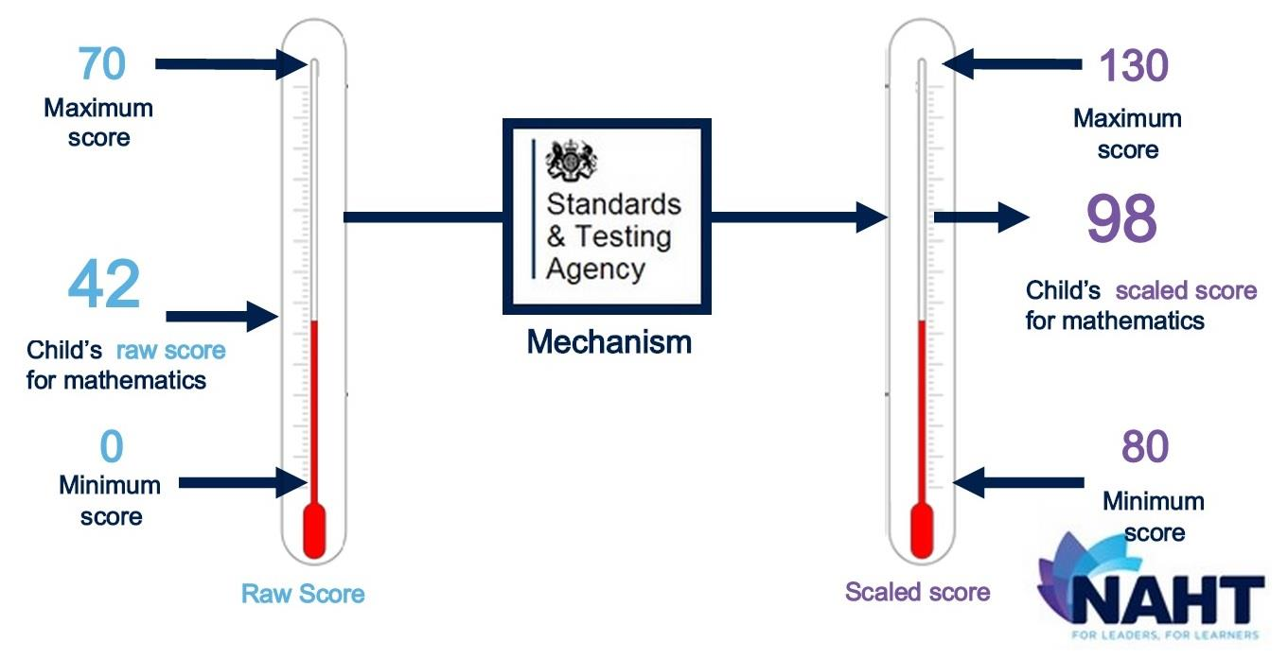

Slide 7
Teacher Assessment
Teacher assessment in Reading, Maths and Science will now take the form of:
  “working at the expected standard” or
  “is not yet working at the expected standard”
Teacher assessment in Writing will take the form of:
  “working towards the expected standard”
  “working at the expected standard” or
  “working at greater depth within the expected standard”

Slide 8
Teacher Assessment
There are no Teacher Assessment scores or levels.
The requirements for the Teacher Assessment standard have been published online by the government and the links are in your booklet.

Slide 9
Who uses the results?
You get your child’s results on the same day as their report in the summer term. This may be before or after the results are released by other schools.
We use the results to help us analyse strengths and areas for development in our curriculum.

Slide 10
Who uses the results?
Your child’s chosen secondary school may use the results to group or set children. You should ask them about how they do this.
The government uses the results to draw up school performance tables.
OFSTED uses the school’s results as part of deciding how effective the school is during inspection.

Slide 11
What is the school doing to prepare for the tests?
We are monitoring your child’s progress carefully and setting individual targets for them in Maths and English.
Where we can work in smaller groups with additional teachers, we are doing so.
We are providing “set” lessons in Maths and English, as well as implementing a carefully planned revision programme.

Slide 12
What is the school doing to prepare for the tests?
We have made our timetable more flexible to allow extra time to be given to the core subjects.
We are continuing to use questions from example test papers to give children practice with the test format.
We believe that it is really important that the children are not ‘stressed out’ by sitting the tests. If the children are used to answering test style questions on a regular basis, this helps to remove the fear factor.

Slide 13
What is the school doing to prepare for the tests?
Practising example paper questions helps children to learn the ‘language of the tests’ and helps them to show their full potential because they learn to interpret what the questions mean.
Practising the format of the new test in Arithmetic.

Slide 14
What is the school doing to prepare for the tests?
Each child has a teacher mentor who they meet weekly.
Most importantly, we want the children to value their learning and show their full potential. We want the children to care about how they do, but not become stressed out by the tests.
We are letting the children know that we want them to achieve their own personal best… and that is good enough for us!

Slide 15
What will happen during the test week?
The test week is Monday 14th – Friday 18th May 2018.
You should not take your child out of school during this week. Please also try to make sure they have full attendance in the preceding weeks. The school will not authorise avoidable absence during this period.

Slide 16
What will happen during the test week?
Date | KS2 Tests
Monday 8 May | English reading test (reading booklet and associated answer booklet) (60 mins, 50 marks)
Tuesday 9 May | English grammar, punctuation and spelling test Paper 1 (Short answer questions) (45 mins, 50 marks) Paper 2 (Spelling) (Not timed, 20 marks)
Wednesday 10 May | Mathematics – Paper 1 (Arithmetic) (30 mins, 40 marks) Mathematics – Paper 2 (Reasoning) (40 mins, 35 marks)
Thursday 11 May | Mathematics - Paper 3 (Reasoning) (40 mins, 35 marks)

Slide 17
What will happen during the test week?
If your child is absent on the day of any test, we must notify the testing agency and they may grant permission for your child to take the test at a later date, subject to certain conditions being met.
The start times of the tests will vary within each day.

Slide 18
What will happen during the test week?
For the majority of children, the tests will take place in their set classrooms, but to make sure all children have enough space and access to appropriate support, we will also use other classrooms and areas around the school.
We will make sure children experience a range of fun, “de-stressing” activities outside of test time.

Slide 19
Special Arrangements
Some children have special arrangements for the tests if they normally have those arrangements in class, for example, help with reading, concentration or help with English words if English is not the child’s first language.
We will let you know if any of these arrangements apply to your child.

Slide 20
What can I do to help in the test week?
Provide calm reassurance. Remind your child that it is important to work hard and do their best, but that their best will be good enough.
Keep everything as normal as possible – make sure activities like clubs and sports go ahead.

Slide 21
What can I do to help in the test week?
Make sure your child gets a good night’s sleep each day.
Please make sure your child eats breakfast during the week. We will offer breakfast to all Year 6 children during the test week. They can arrive at 8am and have cereal, toast and a drink.

Slide 22
What can I do to help in the test week?
Make sure your child arrives at school promptly

Slide 23
What can I do to help between now and the tests?
Make sure your child is reading - not just their school or library book, but newspapers, leaflets, brochures, television and computer screens, cereal packets - in short, ANYTHING!
Ask them questions about their reading.

Slide 24
What can I do to help between now and the tests?
Make sure your child is practising their times tables in their tables booklets (up to 12 x 12) and learning and revising their spellings
Tables and spellings are essential life skills to help your child, not just with tests, but with the work they are going to encounter at secondary school.

Slide 25
What can I do to help between now and the tests?
Provide support for your child as they do homework. Make sure it’s completed and back in school on the right day.
Help your child complete any homework set at Easter.
If you have internet access:
  BBC Bitesize website… www.bbc.co.uk/education
  Sumdog

Slide 26
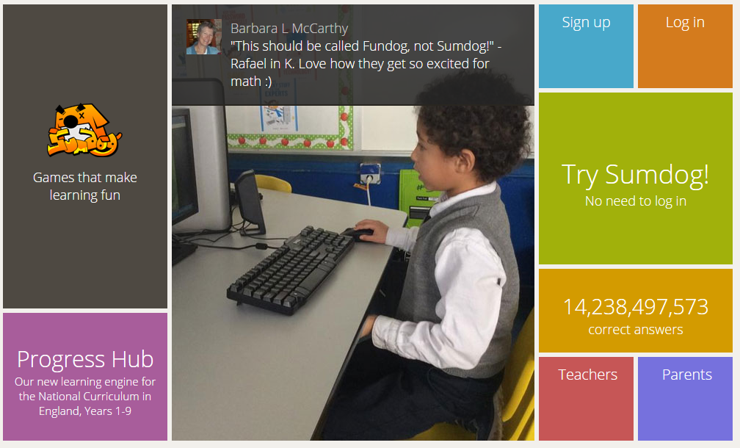

Slide 27
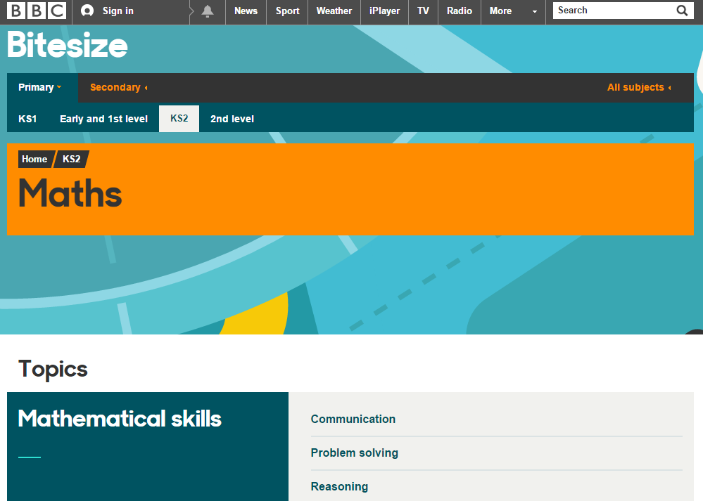
www.bbc.co.uk/education

Slide 28
Any questions?

Slide 29
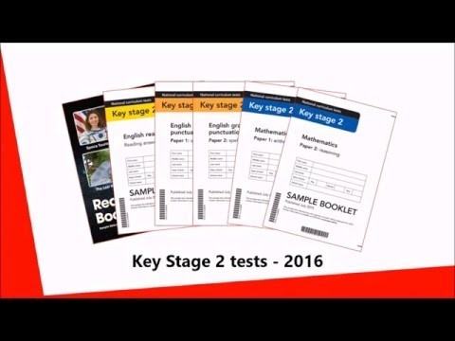
Any questions?

